Slide 1


Creating STEM Contents: Wind Power Christian Kirk, Lyndon Li, Samuel Tando
Sponsor: Wonhyeok Jang

Slide 2

Project Description
Problem statement:
movement towards zero emission, renewable energy sources in the power sector
educate future generation about combating climate change
Our Wind power system will:
teach kids about how energy is generated from the wind
increase exposure to the STEM field
small, highly portable

Slide 3
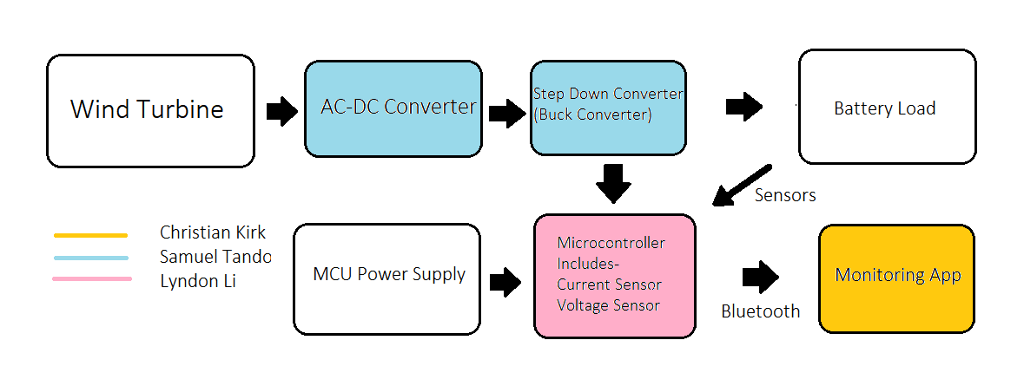
System Overview

Slide 4

Subsystems: AC-DC Converter and Buck Converter
AC-DC Converter will convert AC input from generator to DC output
Buck converter will step down high DC input to 3.3V output for load
Notes:
mention polarity protection, upper voltage protection, generator will provide 3-20 V depending on wind speed, buck converter will lower to 3.3V

Slide 5
Subsystems: Microcontroller Unit
Will receive input readings from the AC/DC converter as well as the Battery Bank
Will output monitor readings to the App via bluetooth and send a signal to the step down converter when battery level is near full

Slide 6

Subsystems: Mobile Application
Android device will connect to the MCU via Bluetooth
Display sensor data from the MCU

Slide 7
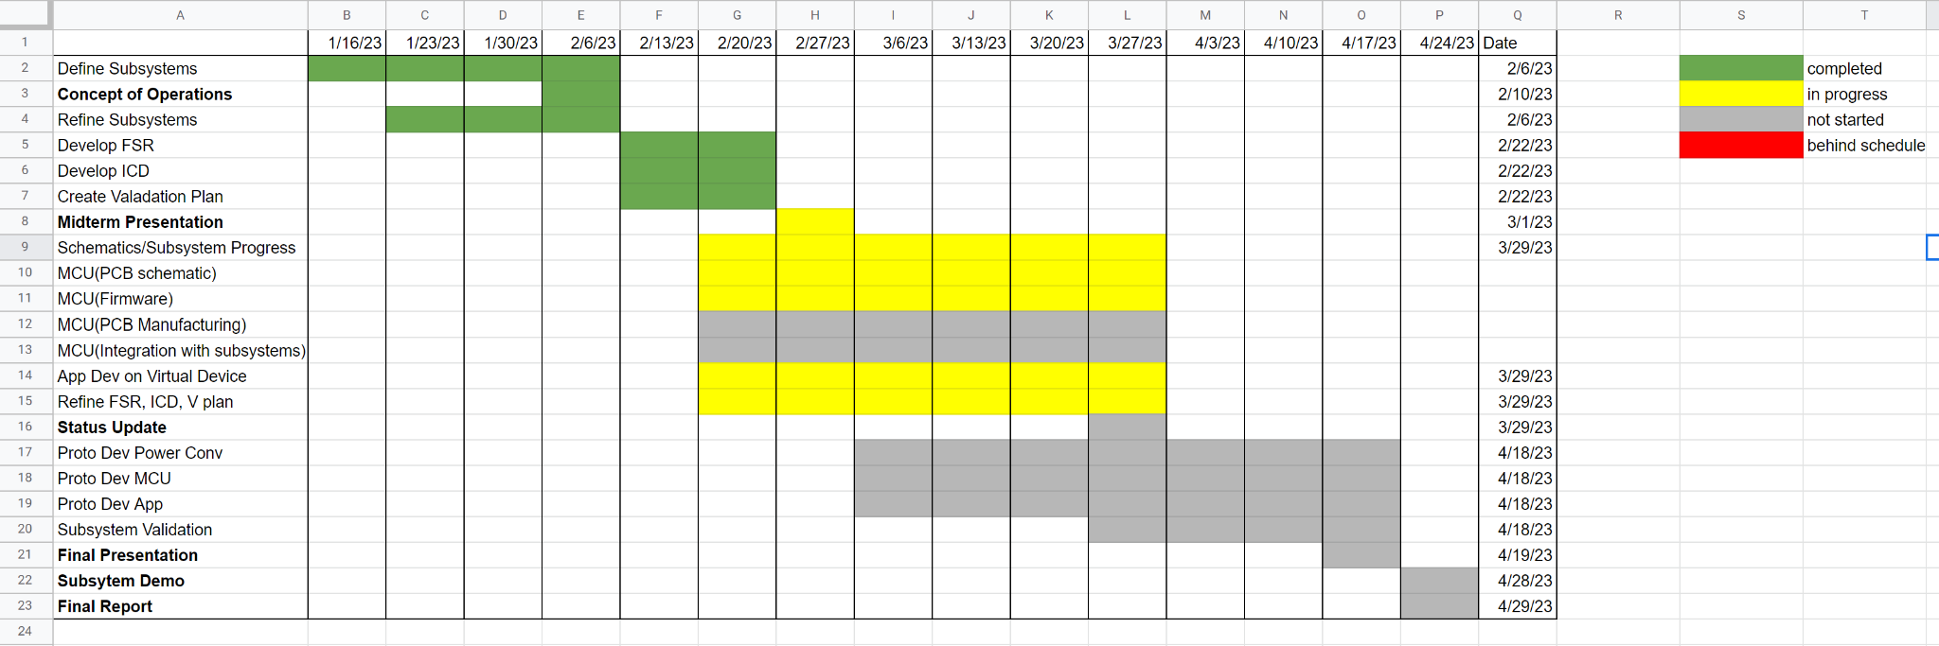
Execution Plan

Slide 8
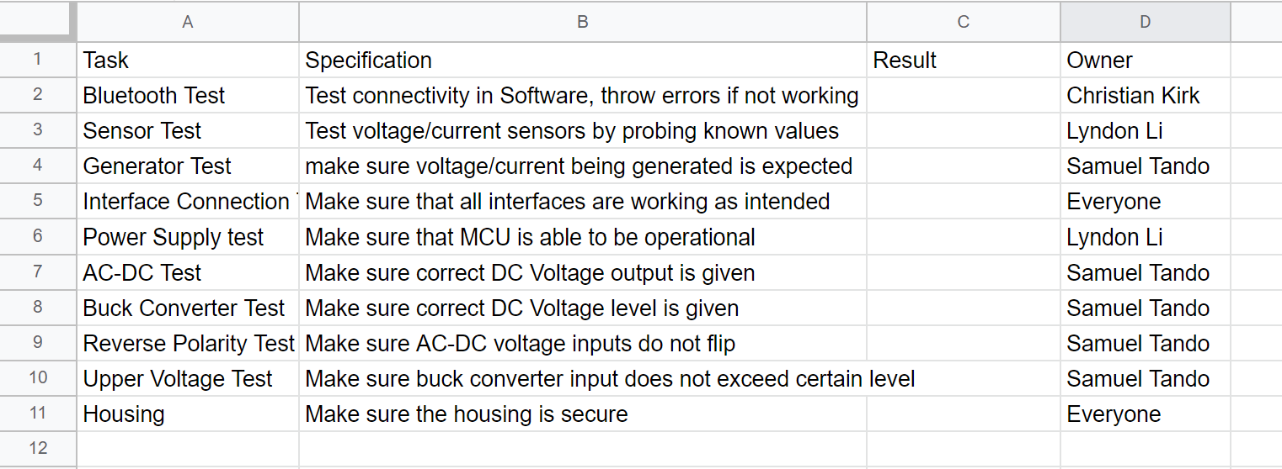
Validation Plan

